Slide 1
Examples of the EHR
BDK08-4 | Secondary Use (Re-Use) of Clinical Information
William Hersh, MD | Department of Medical Informatics & Clinical Epidemiology
Oregon Health & Science University

Slide 2
Examples of the EHR
Using the Veterans Health Information Systems and Technology Architecture (VistA)
Why VistA?
A state-of-the-art EHR that has transformed healthcare in the Veteran’s Health Administration (VHA) (Perlin, 2006; Byrne, 2010)
Not that pretty, but has all of the modern features of the EHR, e.g., clinical decision support (CDS), computerized provider order entry (CPOE), etc.
Distributed under open-source model, unlike most other vendors who do not even allow screen shots to be shown outside their customers’ institutions
(Perlin, 2006; Byrne, 2010)

Slide 3
Some details about VistA
Is available as a demo
Demo version has following screens but not data
Application has two components
Server written in M (formerly called MUMPS), accessed via command-line interface
Runs in commercial Intersystems Cache (on many platforms) or open-source GT.M (Linux only)
Client (called CPRS) written in Delphi and providers graphical user interface
Only runs on Windows (just about all versions)

Slide 4
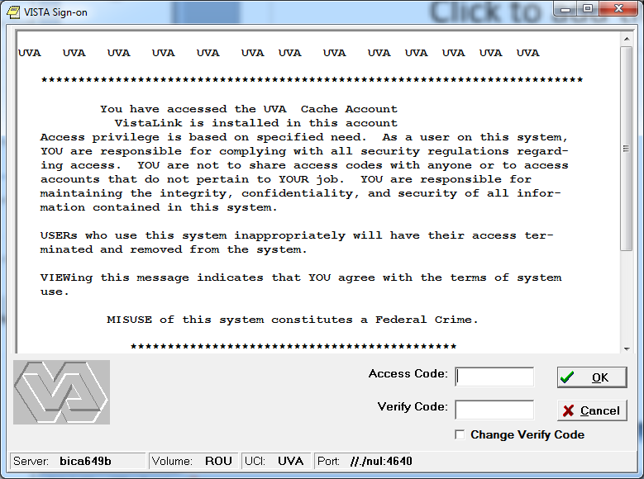
Logging on to CPRS, the front end to VistA

Slide 5
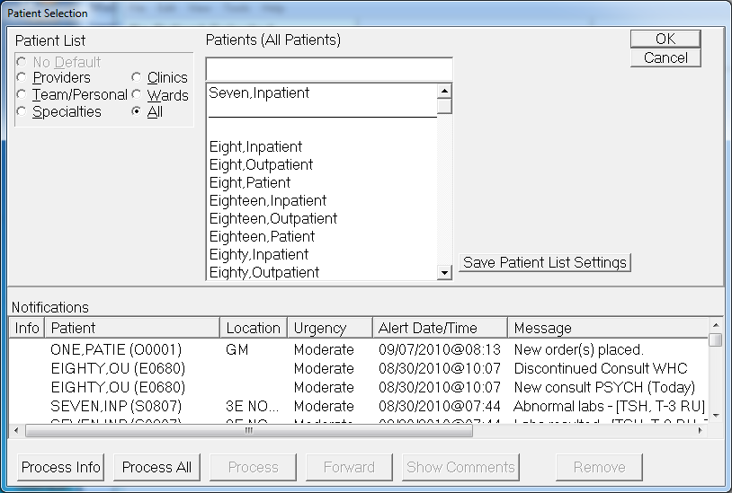
Choosing a patient

Slide 6
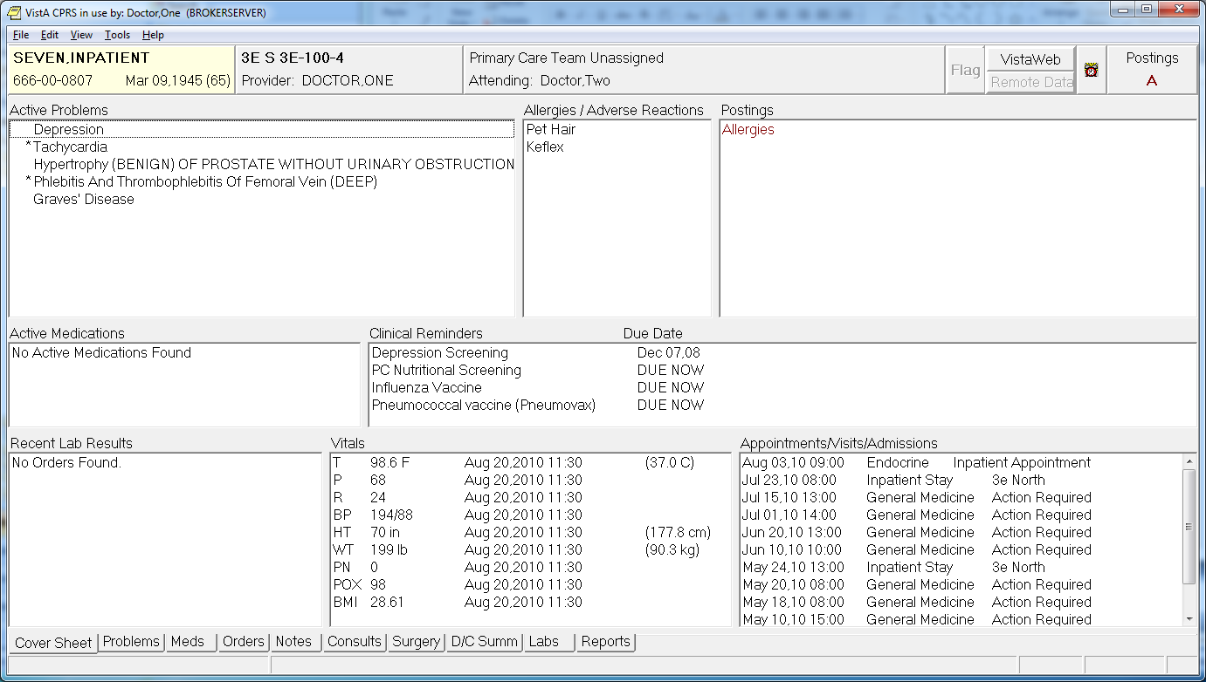
Cover sheet – overview

Slide 7
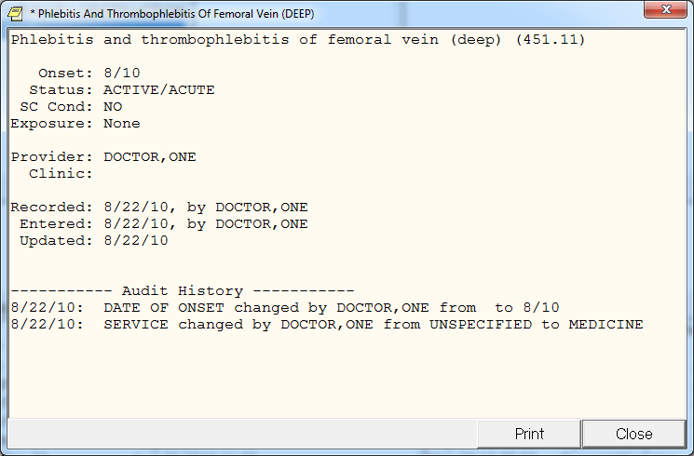
Drilling down to details of a problem

Slide 8
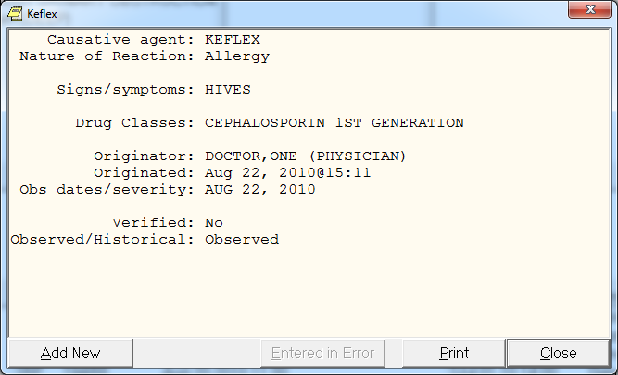
Details of an allergy

Slide 9
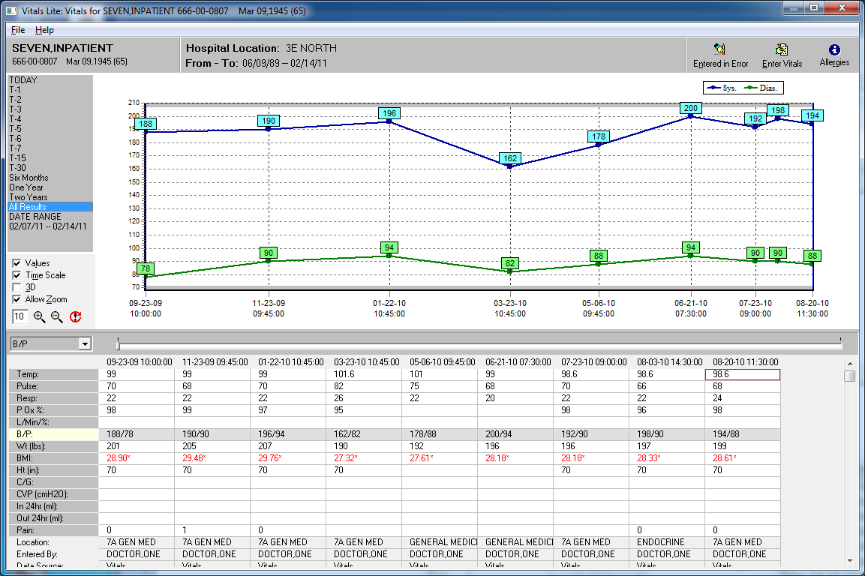
Viewing vital signs over time

Slide 10
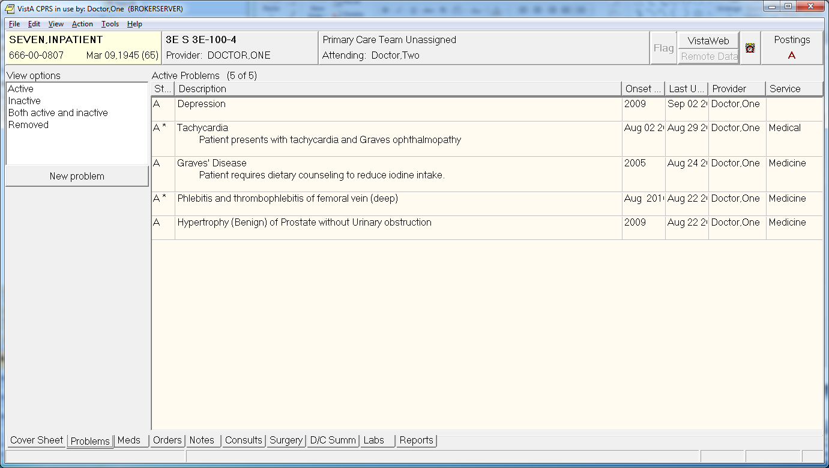
More details on problems

Slide 11
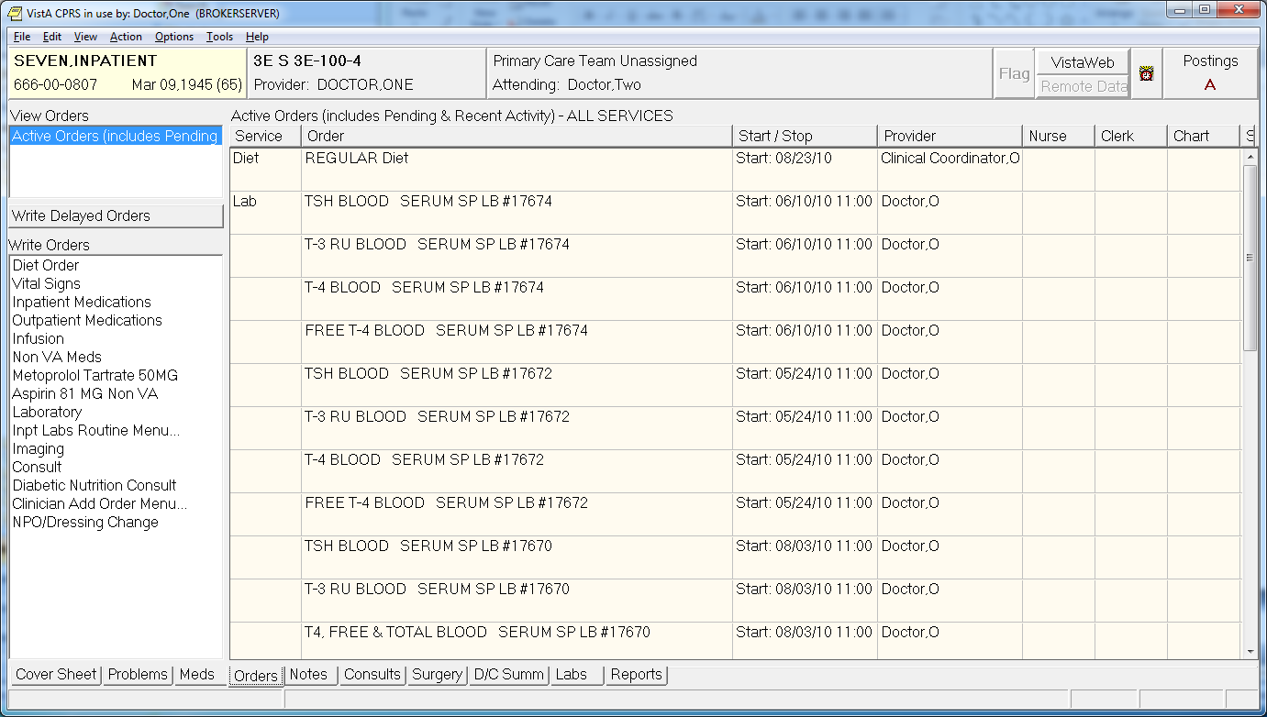
List of active orders

Slide 12
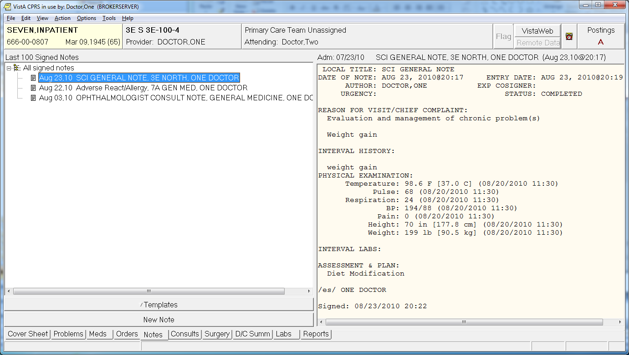
Viewing the patient’s notes

Slide 13
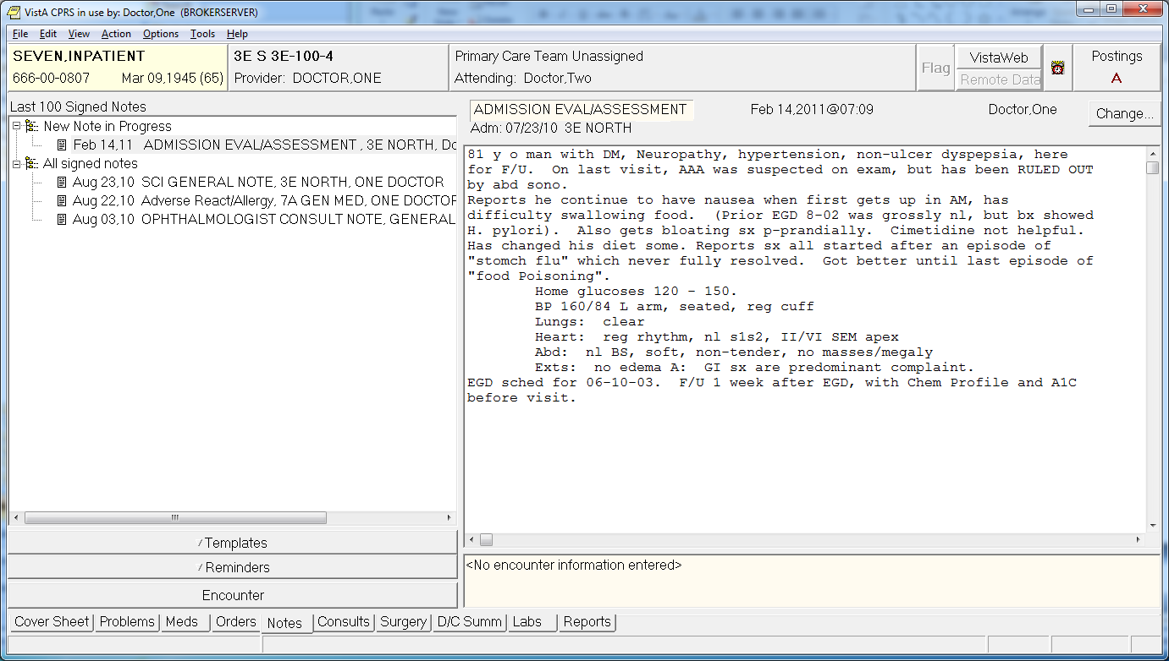
Writing a new note

Slide 14
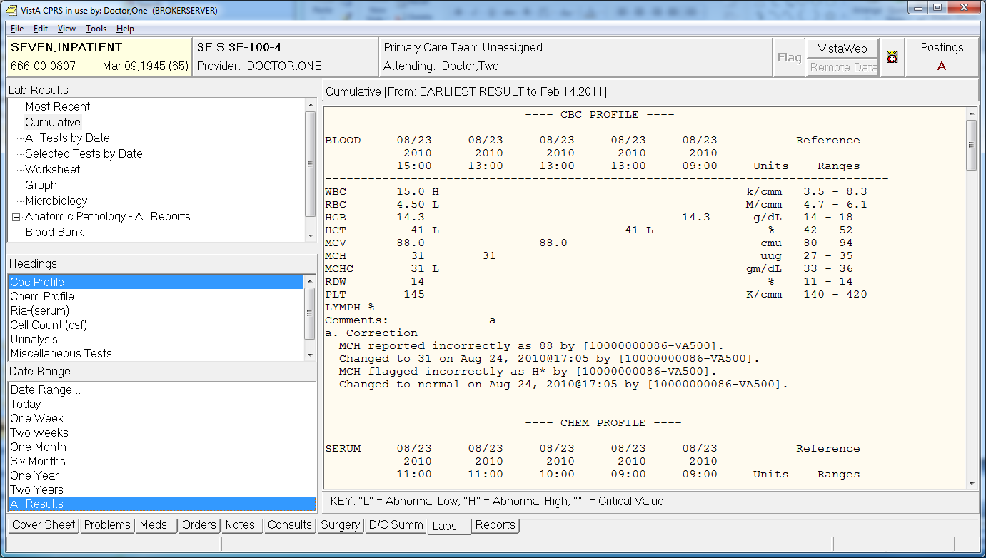
Viewing labs

Slide 15
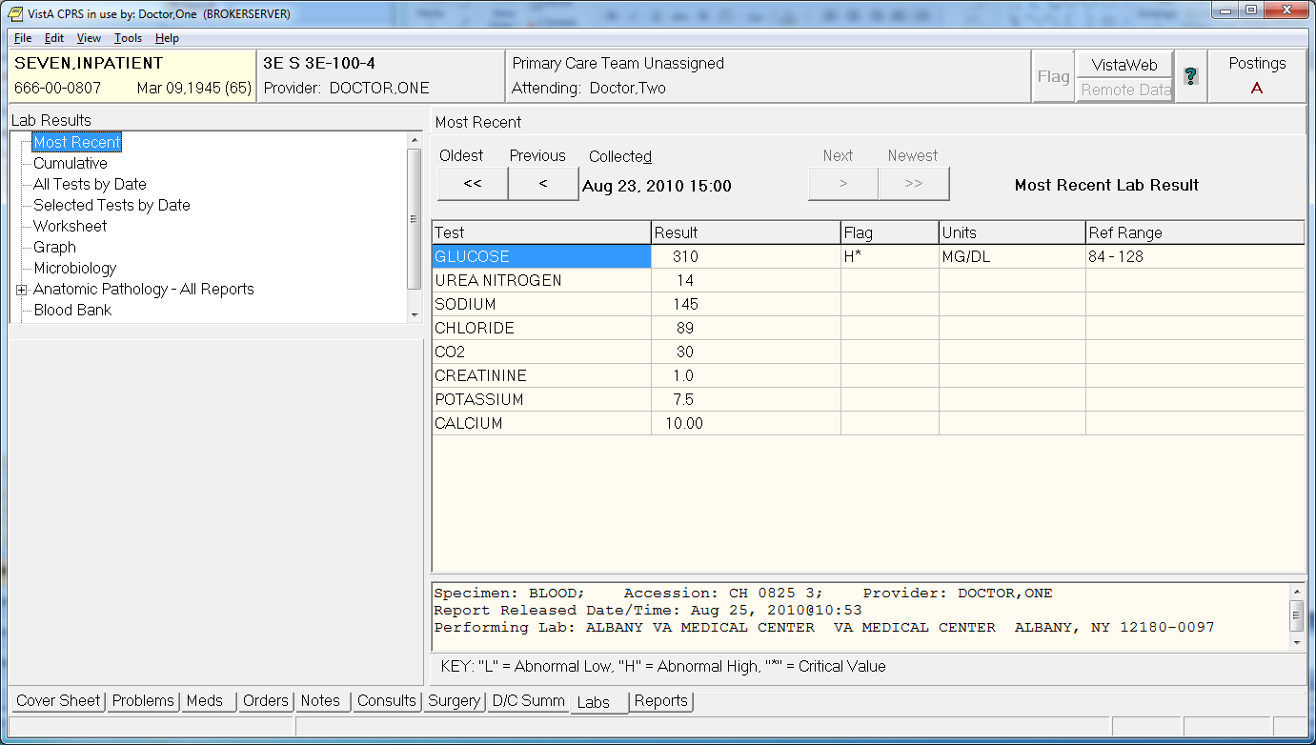
Including critical values

Slide 16
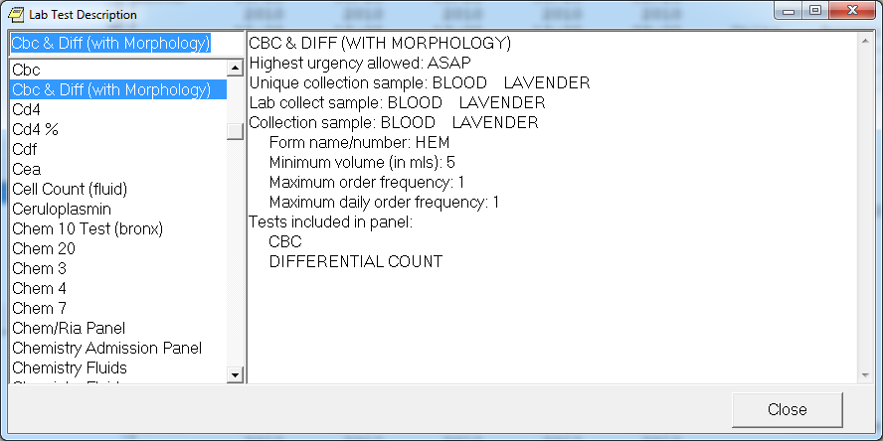
More information on lab tests

Slide 17
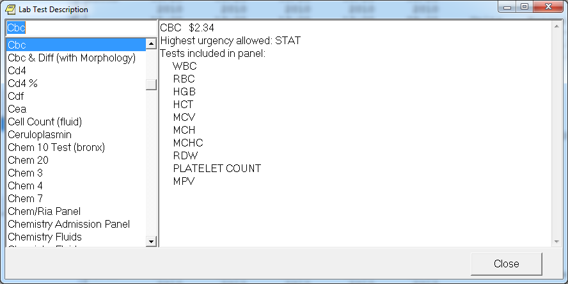
Including (for some) cost

Slide 18
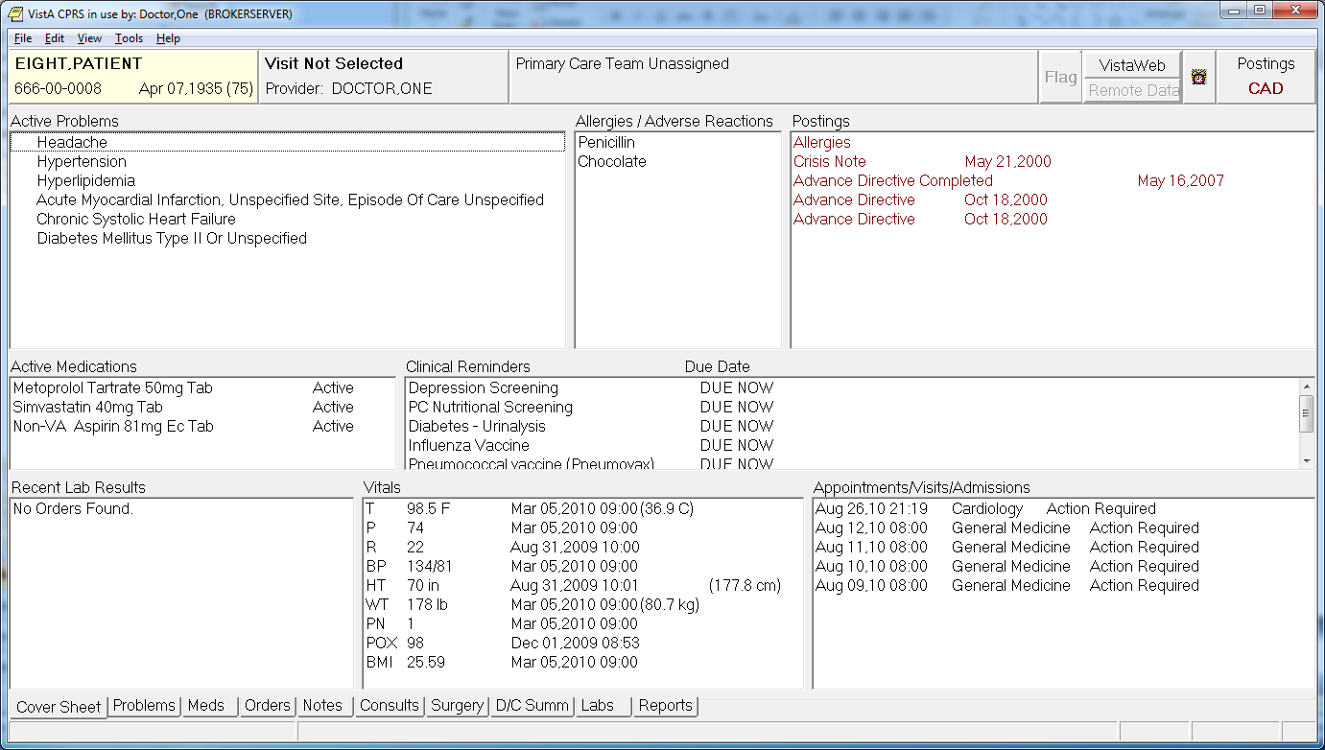
Another patient

Slide 19
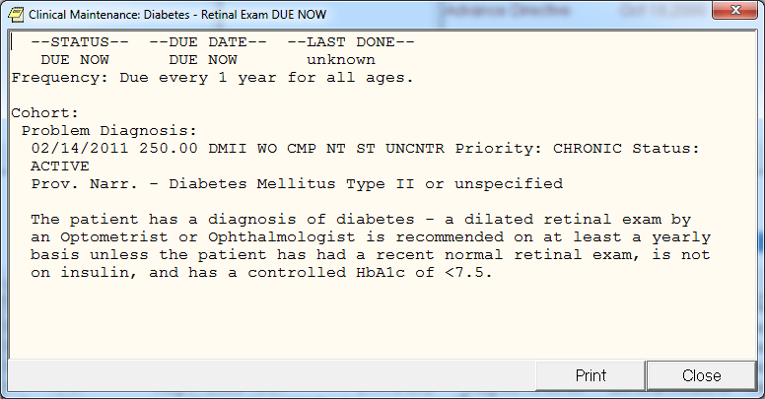
Clinical decision support: reminders

Slide 20
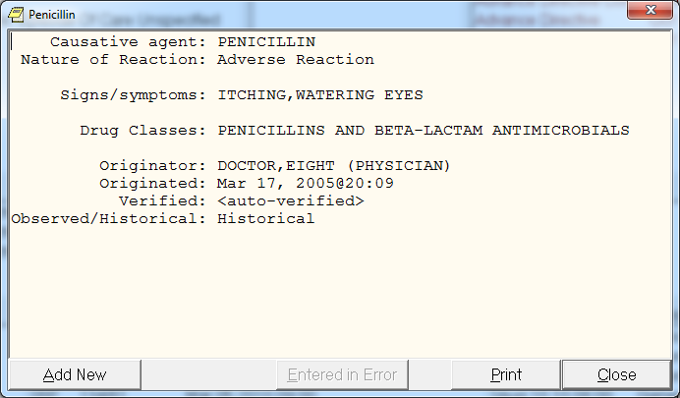
Clinical decision support uses allergy information

Slide 21
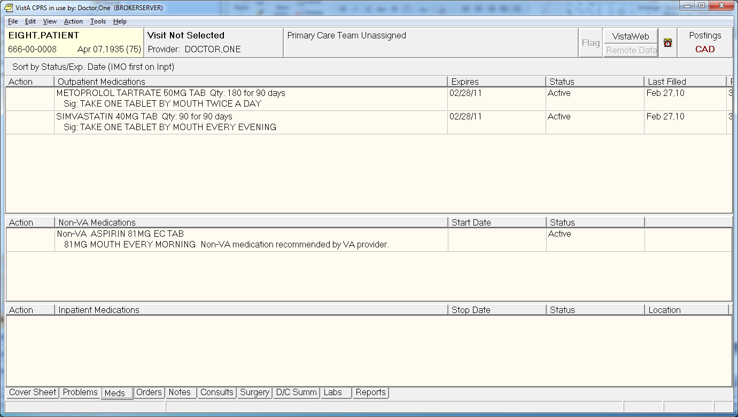
Let’s try to prescribe a medication

Slide 22
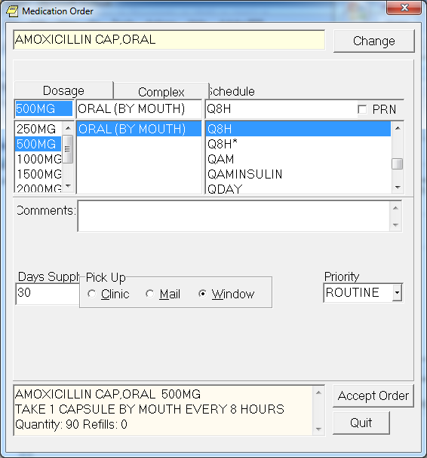
How about some amoxicllin?

Slide 23
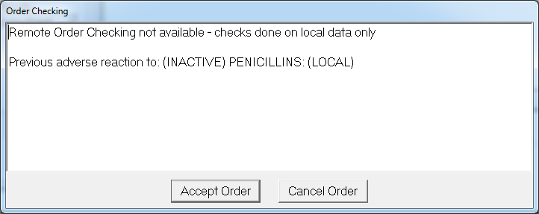
Oops, patient is allergic

Slide 24
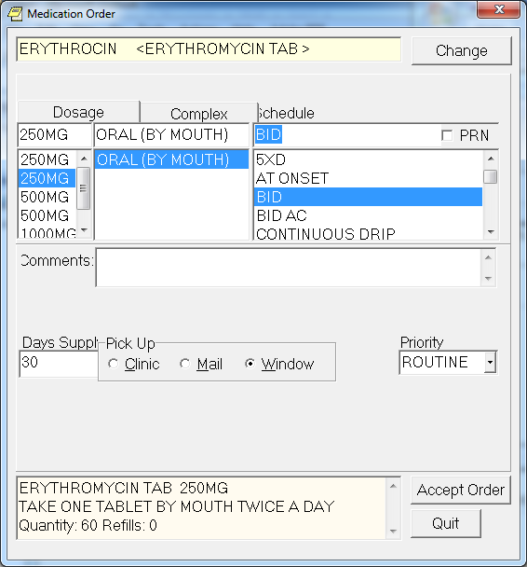
Maybe erythromycin?

Slide 25
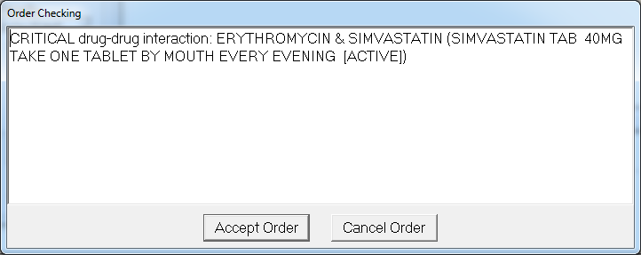
No, interacts with statin drugs

Slide 26
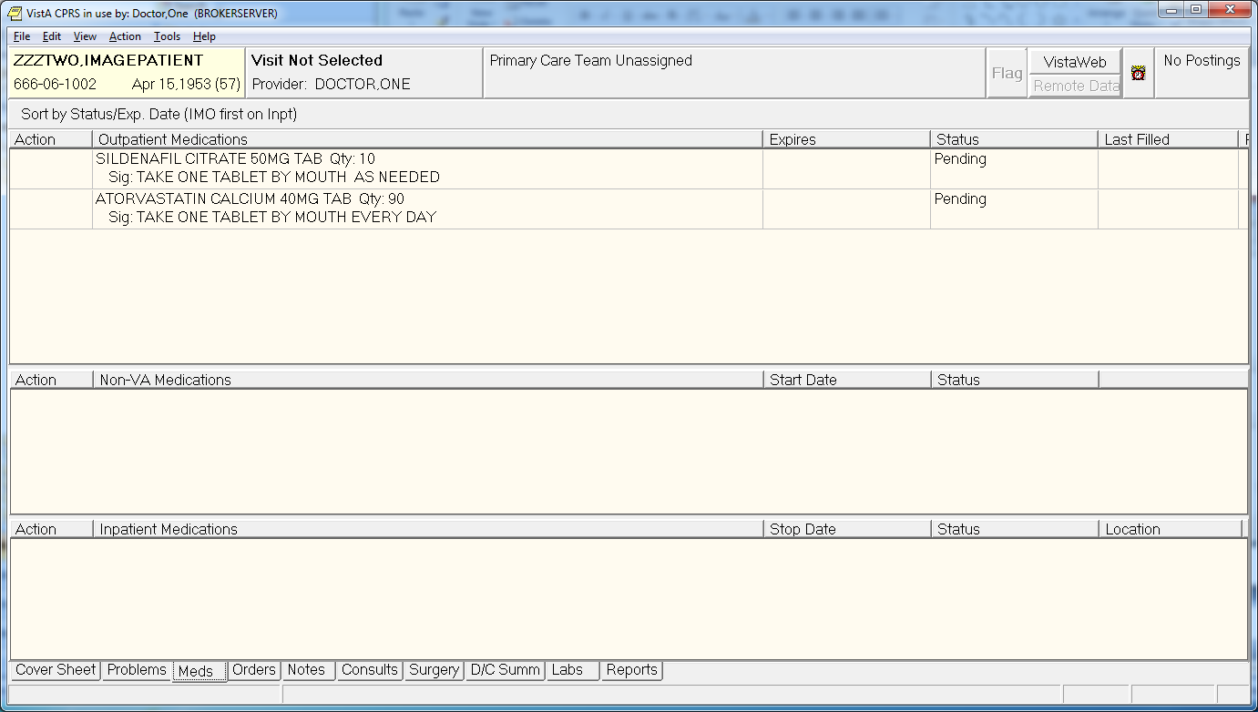
Drug interactions for another patient

Slide 27
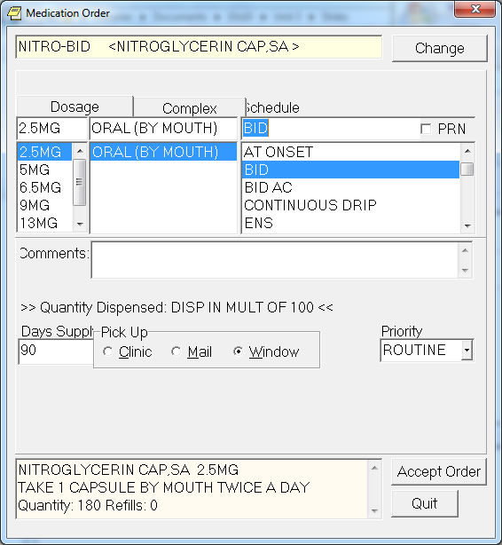
Trying to prescribe nitrates for angina

Slide 28
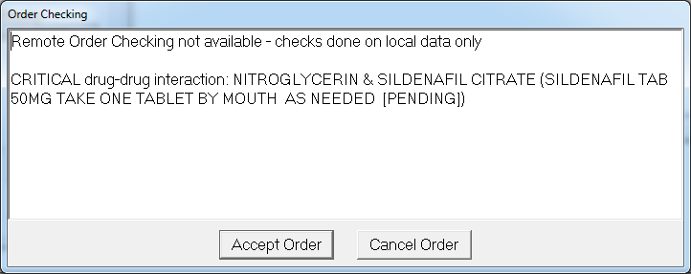
Oops!

Slide 29
Some more about VistA
The pure open-source version is also known as FOIA VistA
There are two other streams of VistA activity
WorldVistA follows a more traditional open-source pathway
OpenVista is more commercially oriented, and some vendors have proprietary extensions from the base code (e.g., Medsphere)
Next generation of VA medical record was to be merged with military record system, Armed Forces Health Longitudinal Technology Application (AHLTA) to form the Virtual Lifetime Electronic Record, but Department of Defense now procuring a commercial EHR
(Conn, 2013), (DOD, 2014)

Slide 30
Other open-source EHRs
Indian Health Service Resource and Patient Management System (RPMS)* – derived from VistA,
ClearHealth*
OpenEHR*†
Tolven*†
OpenMRS†
*US HITECH-certified
†More focused internationally

Slide 31
Despite the appeal of open source, the market belongs to commercial vendors
Few successful implementations of VistA in non-VA settings
One of note: Oroville, CA
Earlier “home grown” EHR systems have given way to commercial systems
One of few left standing: Regenstrief Gopher
Halamka (aka, Geek Doctor) notes “Era of Epic,” where integration and vendor performance trump innovation and “best of breed”
Epic dominates high end of market, e.g., academic and other large medical centers
“No one ever got fired for buying Epic”
Epic methodology focuses on workflow, meaningful use
Product cycle creates effective demand management
(Moukheiber, 2012), (Duke, 2014), (Halamka, 2013)

Slide 32
Who leads the EHR marketplace in US?
Outpatient
Epic dominates in large (>11) physician practices, many of whom are affiliated with large medical centers
Small practice market (0-3 physicians) led by eClinicalWorks
Nearly 500 other vendors, but others with >5% market share include AllScripts, Practice Fusion, and NextGen
Inpatient
Similarly large marketplace but growing dominance by small number of vendors
Four inpatient system vendors achieving highest rates of meaningful use attestation include
Epic
Meditech
Computer Programs and Systems (CPSI)
Cerner
(SK&A, 2015), (McCormack, 2014)

Slide 33
Thank you
Please download the resource list with useful links from the “Resources” tab in the upper right of the player.
This course was made possible under a grant from the NIH (# 1R25GM114820-01)

